Slide 1
End-to-end Driving via Conditional Imitation Learning
Biao Jia biao@cs.unc.edu

Slide 2
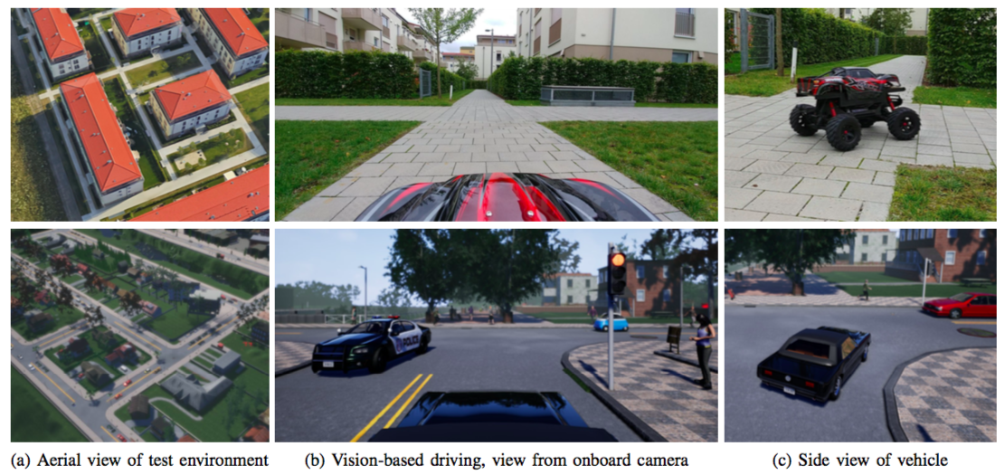
Overview
Notes:
train and evaluate robotic vehicles in the physical world (top) and in simulated urban environments (bottom).
The vehicles drive based on video from a forward-facing onboard camera. At the time these images were taken, the vehicle was given the command “turn right at the next intersection”.
The trained controller handles sensorimotor coordination (staying on the road, avoiding collisions) and follows the provided commands.

Slide 3
Overview

Slide 4
Related Work
Reinforcement Learning
Guided Policy Search
Directed Policy Search
Imitation Learning

Slide 5
Reinforcement Learning
Pollcy π: to control an agent in a stochastic environment
Time step t, observe a state x_t and chooses an action u_t according to π(u_t| x_t)
Producing a state transition according to p(x_t+1 | x_t, u_t). The goal is specified by reward r(x_t, u_t)
ζ denote a sequence of actions and states, with r(ζ) and π(ζ) being the total reward and its probability under π.
Notes:
zeta

Slide 6
Reinforcement Learning
Policy gradient methods learn a parameterized policy π_θ by directly optimizing its expected return E[J(θ)] with the respect to θ.
estimate the gradient E[∇J(θ)] using samples ζ1, . . . , ζm drawn from the current policy πθ, and then improve the policy by taking a step along this gradient.
The gradient can be estimated using the following equation:

Slide 7
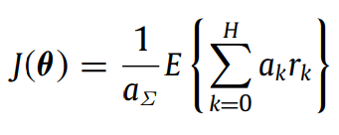
Reinforcement Learning
∇log πθ(ζi) decomposes to sum of ∇log πθ(ut|xt)
is optimized where ak denote time-step-dependent weighting factors and aΣ is a normalization factor in order to ensure that the normalized weights ak/aΣ sum up to one.

Slide 8
Direct/Guided Policy Search
Direct policy search, carefully choose a specialized policy class to to learn the policy in a reasonable number of iterations without falling into poor local optima.
Guided policy search algorithm uses differential dynamic programming (DDP) to generate “guiding samples,” which assist the policy search by exploring high-reward regions.
By initializing DDP with example demonstrations, method can perform learning from demonstration.

Slide 9
Directed Policy Search
An Application of Reinforcement Learning to Aerobatic Helicopter Flight
a pilot fly the helicopter to help find a helicopter dynamics model and a reward (cost) function.
Using reinforcement learning algorithm to find the controller.
differential dynamic programming (DDP), an extension of the linear quadratic regulator (LQR).

Slide 10
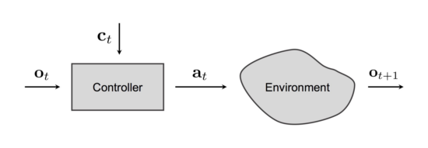
Imitation Learning
The basic idea behind imitation learning is to train a controller that mimics an expert.
Controller receives an observation o_t from the environment and a command c_t. It produces an action a_t that affects the environment, advancing to the next time step.

Slide 11
Imitation Learning
The training data is a set of observation- action pairs D = {<o_i,a_i>} generated by the expert. The assumption is that the expert is successful at performing the task of interest and that a controller trained to mimic the expert will also perform the task well.
This is a supervised learning problem, in which the parameters θ of a function approximator F(o;θ) must be optimized to fit the mapping of observations to actions:
Notes:
An implicit assumption behind this formulation is that the expert’s actions are fully explained by the observations.

Slide 12
Imitation Learning
An implicit assumption behind this formulation is that the expert’s actions are fully explained by the observations.
There exists a function E that maps observations to the expert’s actions:
a_i = E(o_i)
If this assumption holds, a sufficiently expressive approximator will be able to fit the function E given enough data.

Slide 13
Imitation Learning
However, in more complex scenarios the assumption that the mapping of observations to actions is a function breaks down.
Consider a driver approaching an intersection. The drivers' subsequent actions are not explained by the observations, but are additionally affected by the driver’s internal state, such as the intended destination.
The same observations could lead to different actions, depending on this latent state.

Slide 14
Conditional Imitation Learning
To address this, we begin by explicitly modeling the expert’s internal state by a vector h, which together with the observation explains the expert’s action: a_i = E(o_i,h_i).
h can include information about the expert’s intentions, goals and prior knowledge. The conditional imitation learning objective can be rewritten as:

Slide 15
Conditional Imitation Learning
We expose the latent state h to the controller by introducing an additional command input: c = c(h).
At training time, the command c is provided by the expert. At test time, commands can be used to affect the behavior of the controller, which come from a human user or a planning module. “turn right at the next intersection”.
The training dataset becomes D = {<o_i, c_i, a_i>}

Slide 16
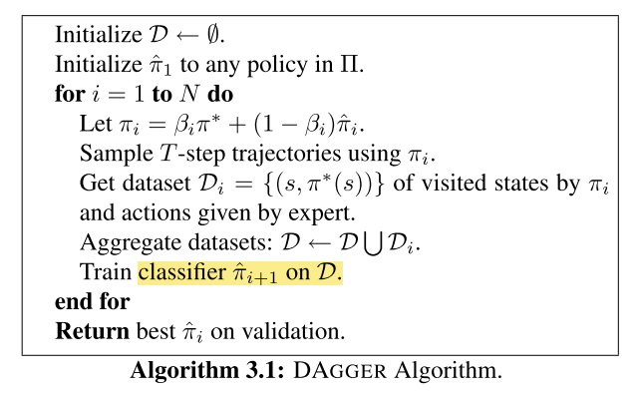
DAGGER
DAGGER (Dataset Aggregation), an iterative algorithm that trains a deterministic policy that achieves good performance guarantees under its induced distribution of states.

Slide 17
DAGGER
At the first iteration, it uses the expert’s policy to gather a dataset of trajectories D and train a policy π1 that best mimics the expert on those trajectories.
Then at iteration n, it uses π_n to collect more trajectories and adds those trajectories to the dataset D. The next policy π_n+1 is the policy that best mimics the expert on the whole dataset D.
In other words, DAGGER proceeds by collecting a dataset at each iteration under the current policy and trains the next policy under the aggregate of all collected datasets.

Slide 18
DAGGER
To better leverage the presence of the expert in our imitation learning setting, we optionally allow the algorithm to use a modified policy πi = βiπ + (1 − βi)πi at iteration i that queries the expert to choose controls a fraction of the time while collecting the next dataset.
We will typically use β1 = 1 so that we do not have to specify an initial policy π1 before getting data from the expert’s behavior. Then we could choose βi = p^(i−1) to have a probability of using the expert that decays exponentially.

Slide 19
Imitation Sample in Manipulation
Here is a imitation learning process of flattening.
Human changes position of his/her hands every run, the possibility of using the expert motion planner decrease every run, in the last several runs, the motion is fully generated by the learned model.
Notes:
Here is a imitation learning process of flattening. Human changes position of his/her hands every run, the possibility of using the expert motion planner decrease every run, in the last several runs, the motion is fully generated by the learned model.

Slide 20
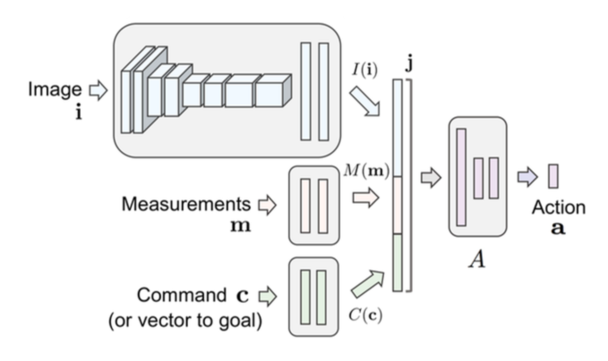
Deep Network Structure
Notes:
command input: the command is processed as input by the network, together with the image and the measurements

Slide 21
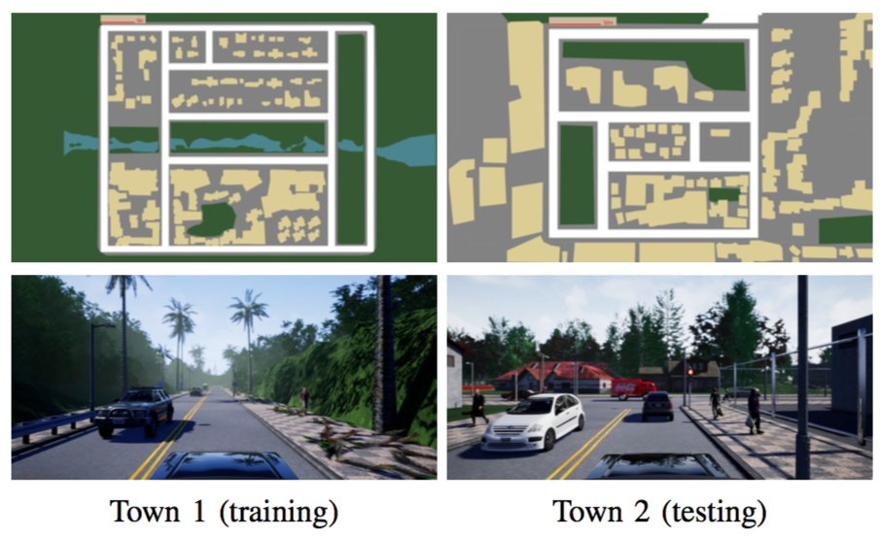
Simulated Environment
Town 1 is used for training. Town 2 is used for testing (right). Map on top, view from onboard camera below.
The the difference in visual style.

Slide 22
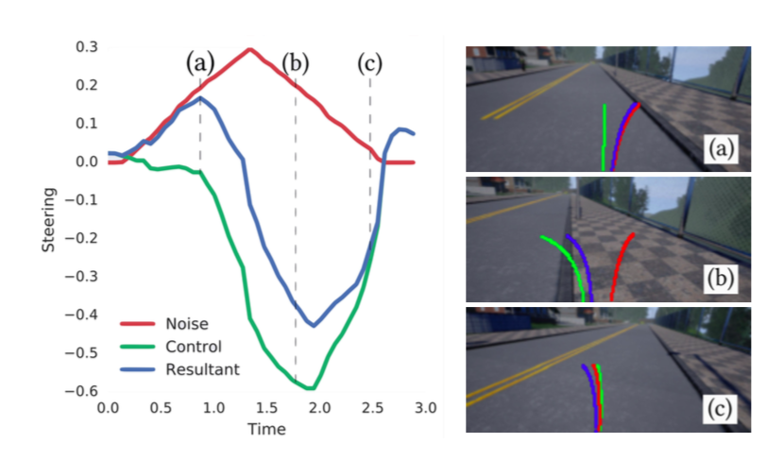
Simulation Data Collection
Noise injection in data collection.
Notes:
The fragment is an actual driving sequence from the training set.
The plot on the left shows steering control versus time.
In the plot, the red curve is an injected triangular noise signal, the green curve is the driver’s steering signal, and the blue curve is the steering signal provided to the car, which is the sum of the driver’s control and the noise.
Images on the right show the driver’s view at three points in time.
Between times 0 and roughly 1.0, the noise produces a drift to the right, as illustrated in image (a).
This triggers a human reaction, from 1.0 to 2.5 seconds, illustrated in (b).
Finally, the car recovers from the disturbance, as shown in (c). Only the driver-provided signal (green curve on the left) is used for training.

Slide 23
Reference
Ross, Stéphane, Geoffrey J. Gordon, and Drew Bagnell. "A reduction of imitation learning and structured prediction to no-regret online learning." International Conference on Artificial Intelligence and Statistics. 2011.
Codevilla, Felipe, et al. "End-to-end driving via conditional imitation learning." arXiv preprint arXiv:1710.02410 (2017).

